Slide 1
Structures and Strategies for State Space Search(1)
하 진 영
강원대학교 컴퓨터공학과

Slide 2
Introduction
Predicate calculus as an example of AI representation language
  well-formed predicate calculus expression
    provide a means of describing objects and relations in a problem domain
  inference rules
    allow to infer new knowledge from these description
    define a space that is searched to find a problem solution

Slide 3
Introduction (2)
Successful design and implementation
  programmer must be able to analyze and predict behavior of search algorithms
Questions
  Is the problem solver guaranteed to find a solution?
  Will the problem solver always terminate, or can it become caught in an infinite loop?
  When a solution is found, is it guaranteed to be optimal?

Slide 4
Introduction (3)
Questions (cont’d)
  What is the complexity of the search process in terms of time usage? Space usage?
  How can the interpreter most effectively reduce search complexity?
  How can an interpreter be designed to most effectively utilize a representation language?

Slide 5
State Space Search
State space search
  primary tool for answering the questions
By representing a problem as a state space graph
  we can use graph theory to analyze
    the structure and
    complexity of both the problem and the procedures used to solve it

Slide 6
Graph Theory
A graph consists of
  a set of nodes and
  a set of arcs or links connecting pairs of nodes
State space model
  nodes: discrete states in a problem-solving process
    results of logical inferences or
    configurations of a game board
  arcs: transition between states
    logical inferences or
    legal moves of a game

Slide 7
Graph Theory (2)
Graph theory
  invented by Euler in early 18th century
  the bridges of Königsberg problem
    asks if there is a walk around the city that crosses each bridge exactly once
    the residents doubted that it was possible, no one had proved its impossibility

Slide 8
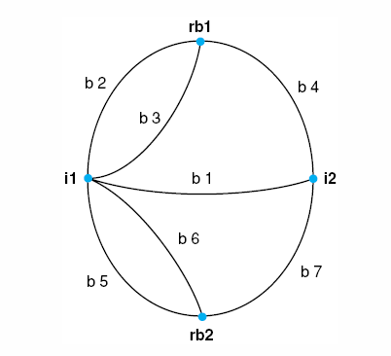
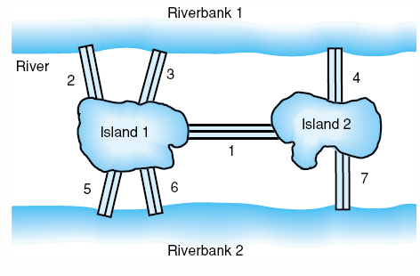
The Bridges of
Königsberg Problem
Graph representation
  preserves the essential structure of the bridge system, while ignoring extraneous features such as distance and direction

Slide 9
Predicate Calculus Representation
The connect predicate
  corresponds to an arc of the graph, asserting that two land masses are connected by a particular bridge
  connect(i1,i2,b1). connect(i2,i1,b1). connect(rb1,i1,b2). connect(i1,rb1,b2). connect(rb1,i1,b3). connect(i1,rb1,b3). connect(rb1,i2,b4). connect(i2,rb1,b4). connect(rb2,i1,b5). connect(i1,rb2,b5). connect(rb2,i1,b6). connect(i1,rb2,b6). connect(rb2,i2,b7). connect(i2,rb2,b7).

Slide 10
Predicate Calculus Representation(2)
Equivalent to the graph representation
  in that the connectedness is preserved
  an algorithm could translate between the two representations with no loss of information
However
  the structure is made explicit in the graph representation,
  whereas it is left implicit in the predicate calculus

Slide 11
Euler path
Euler noted that
  unless a graph contained either exactly zero or two nodes of odd degree, the walk was impossible
Königsberg problem → Euler path finding
Predicate calculus representation
  does not suggest the concept of the degree of a node
Power of graph theory for
  analyzing the structure of objects, properties, and relationships

Slide 12
Definitions
Graph
  A graph consists of
    A set of nodes N₁, N₂, N₃,… N_{n}…, which need not be finite.
    A set of arcs that connect pairs of nodes.
  A directed graph has an indicated direction for traversing each arc.
  If a directed arc connects N_{j} and N_{k}, then N_{j} is called the parent of N_{k} and N_{k}, the child of N_{j}. If the graph also contains an arc (N_{j}, N_{l}), then N_{k} and N_{l} are called siblings.

Slide 13
Definition (cont’d)
Graph
  A rooted graph has a unique node N_{S} from which all paths in the graph originate.
  A tip or leaf node is a node that has no children.
  An ordered sequence of nodes [N₁, N₂, N₃,…, N_{n}], where each N_{i}, N_{i+1} in the sequence represents an arc (N_{i}, N_{i+1}), is called a path of length n-1 in the graph.
  On a path in a rooted graph, a node is said to be an ancestor of all nodes positioned after it (to its right) and a descendant of all nodes before it (to its left).

Slide 14
Definition (cont’d)
Graph
  A path that contains any node more than once is said to contain a cycle or loop.
  A tree is a graph in which there is a unique path between every pair of nodes.
  The edges in a rooted tree are directed away from the root. Each node in a rooted tree has a unique parent.
  Two nodes in a graph are said to be connected if a path exists that includes them both.

Slide 15
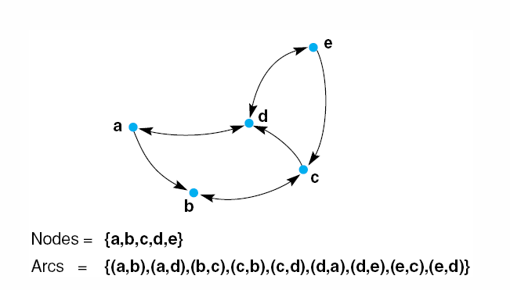
A Labeled Directed Graph

Slide 16
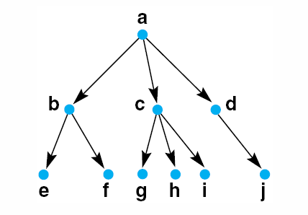
A Rooted Tree

Slide 17
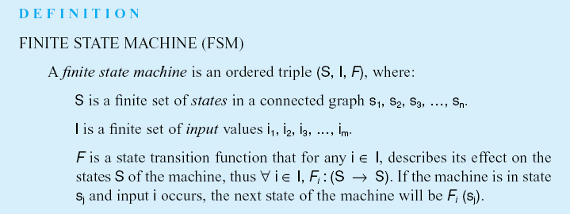
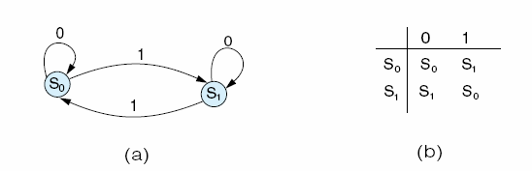
Fig 3.5 (a) The finite state graph for a flip flop and
(b) its transition matrix.
Luger: Artificial Intelligence, 5th edition. © Pearson Education Limited, 2005
7
Notes:
OWEN: Insert def box p85 plus fig 3.5 a and b

Slide 18
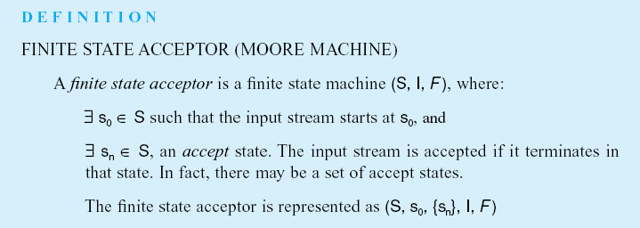
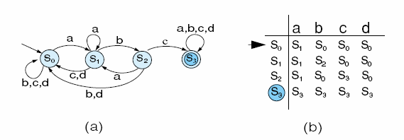
Fig 3.6 (a) The finite state graph and (b) the transition matrix for string recognition example
Luger: Artificial Intelligence, 5th edition. © Pearson Education Limited, 2005
8
Notes:
OWEN: Insert def box p 86 plus fig 3.6 a and b

Slide 19
State Space Representation of Problems
Nodes of a graph
  correspond to partial problem solution states
Arcs
  correspond to steps in a problem-solving process
Initial state
  corresponds to the given information in a problem instance
  forms the root of the graph
Goal condition
  the solution to a problem instance
State space search
  problem solving→ process of finding a solution path from the start state to a goal

Slide 20
State Space Representation of Problems (2)
Goal
  may describe a state
    winning board in tic-tac-toe or
    goal configuration in the 8-puzzle
  alternatively can describe
    some property of the solution path itself
      travelling sales person problem
      parsing problem

Slide 21
State Space Representation of Problems (3)
Arc of the state space
  corresponds to steps in a solution process
Paths through the space
  represent solutions in various stages of completion
Search
  paths are searched, beginning at the start state and continuing through the graph, until either the goal description is satisfied or they are abandoned
  actual generation of new states along the path is done by applying operators to existing states on a path
    “legal moves” in game or
    inference rule in a logic problem or expert systems

Slide 22
Definition
State space search
  A state space is represented by a four-tuple [N,A,S,GD], where:
    N is the set of nodes or states of the graph. These correspond to the states in a problem-solving process.
    A is the set of arcs (or links) between nodes. These correspond to the steps in a problem-solving process.
    S, a nonempty subset of N, contains the start state(s) of the problem.
    GD, a nonempty subset of N, contains the goal state(s) of the problem. The states in GD are described using either:
      A measurable property of the states encountered in the search.
      A property of the path developed in the search.
  A solution path is a path through this graph from a node in S to a node in GD.

Slide 23
Problems in Search
States can sometimes be reached through different paths
  important to choose the best path
Multiple paths to a state can lead to loops or cycles in a solution path
  prevent the algorithm from reaching a goal
  important to distinguish between problems whose state space is a tree and those that may contain loops
  general graph search algorithms
    must detect and eliminate loops

Slide 24
Example: Tic-Tac-Toe
State space representation
  start state: empty board
  goal description: board state having three Xs in a row, column, or diagonal
  path from the start state to a goal state: gives the series of moves in a winning game
  state space
    a tree rather than a graph
    DAG(directed acyclic graph)
    9! (362,880) different paths
    c.f. chess (10¹²⁰), checkers (10⁴⁰)

Slide 25
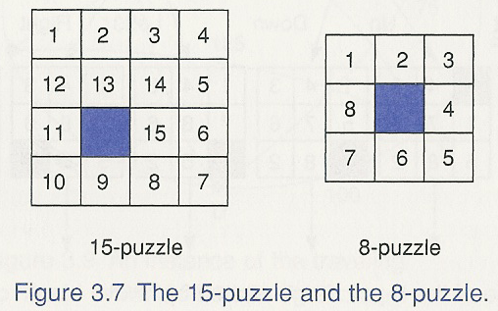
Example: The 8-Puzzle
15-Puzzle and 8-Puzzle
  15-puzzle: 16!→completely intractable
  8-puzzle: smaller state space, and used for example

Slide 26
Example: The 8-Puzzle (2)
The legal moves
  move the blank up ↑
  move the blank right →
  move the blank down ↓
  move the blank left ←
All four moves are not applicable at all times
  when the blank is in one of the corners only two moves are possible

Slide 27
Example: The 8-Puzzle (3)
State
  could be represented by 3x3 array
  predicate calculus
    nine parameters (for the location of numbers in the grid)
    four procedures, describing each of the possible moves of the blank, define the arcs in the state space
State space
  a graph
  cycles are possible unlike Tic-Tac-Toe
  GD: particular state or board configuration
  note that the complete state space of the 8- and 15-puzzle consists of two disconnected subgraphs

Slide 28
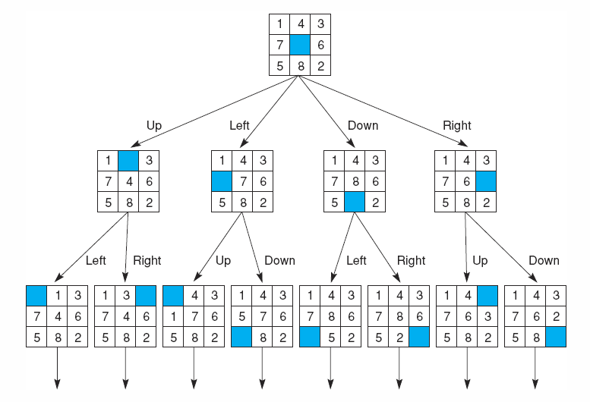
8-Puzzle
Fig 3.8 State space of the 8-puzzle generated by “move blank” operations

Slide 29
Example:
Traveling Salesperson Problem
Goal of the problem
  to find the shortest path for the salesperson to travel, visiting each city, and then return to the starting city
Assumption
  the salesperson lives in city A and will return there
Goal description
  a complete circuit with minimum cost

Slide 30
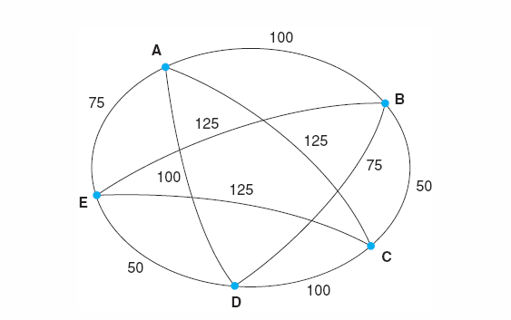
Instance of TSP

Slide 31
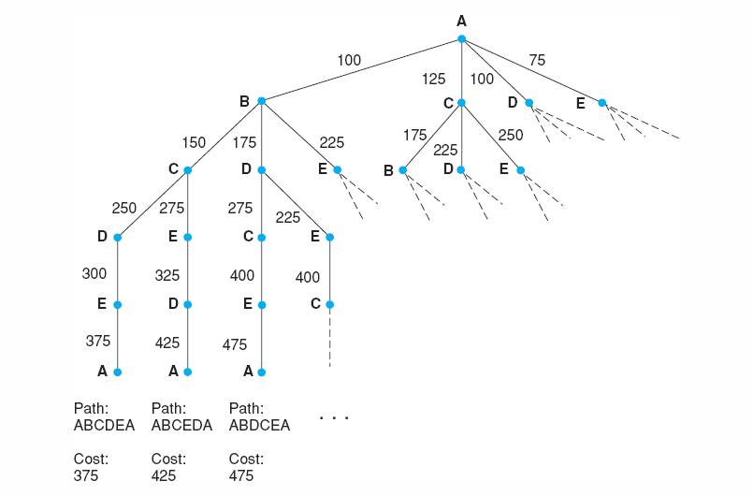
Fig 3.10 Search for the travelling salesperson problem. Each arc is marked with the total weight of all paths from the start node (A) to its endpoint.

Slide 32
Example:
Traveling Salesperson Problem(2)
Complexity of exhaustive search
  (N - 1) !
Techniques to reduce search complexity
  branch and bound (Horowitz and Sahni, 1978)
    reduced to 1.26^{N} : still leaves an exponential number of paths
  “go to the closest unvisited city”
    highly efficient, but fallible
    possible compromise when the time required makes exhaustive search impractical

Slide 33
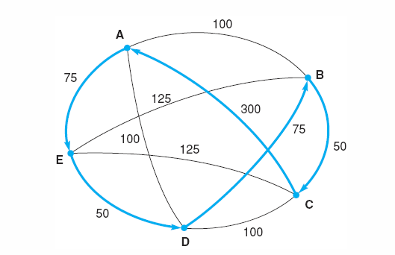
Fig 3.11 An instance of the travelling salesperson problem with the nearest neighbor path in bold. Note this path (A, E, D, B, C, A), at a cost of 550, is not the shortest path. The comparatively high cost of arc (C, A) defeated the heuristic.

Slide 34
Strategies for State Space Search
Data-driven and Goal-driven search
  Data-driven search
    sometimes called forward chaining
    the problem solver begins with the given facts of the problem and a set of legal moves or rules for changing state
    Search proceeds by applying rules to facts to produce new facts, which are in turn used by the rules to generate more new facts. This process continues until (we hope!) it generates a path that satisfies the goal condition.

Slide 35
Strategies for State Space Search(2)
Data-driven and Goal-driven search
  Goal-driven search
    take the goal that we want to solve
    see what rules or legal moves could be used to generate this goal and
    determine what conditions must be true to use them
    these conditions become the new goals, or subgoals, for the search
    search continues, working backward through successive subgoals until (we hope!) it works back to the facts of the problem. This finds the chain of moves or rules leading from data to a goal, although in reverse order
    called goal-driven reasoning or backward chaining

Slide 36
Data-Driven Reasoning and Goal-Driven Reasoning
Data-driven reasoning takes the facts of the problem and applies the rules and legal moves to produce new facts that lead to a goal.
Goal-driven reasoning focuses on the goal, finds the rules that could produce the goal, and chains backward through successive rules and subgoals to the given facts of the problem.

Slide 37
Data-Driven Reasoning and Goal-Driven Reasoning
Both reasoning search the same state space graph
  the order and actual number of states searched can differ
  the preferred strategy is determined by the properties of the problem itself
    complexity of the rules
    “shape” of the state space
    nature and availability of the problem data
  e.g. “I am a descendant of Tomas Jefferson”
    confirming or denying the statement

Slide 38
Goal-Driven Search
Suggested if:
  A goal or hypothesis is given in the problem statement or can easily be formulated (MYCIN).
  There are a large number of rules that match the facts of the problem and thus produce an increasing number of conclusions or goals.
  Problem data are not given but must be acquired by the problem solver.
Thus uses knowledge of the desired goal to guide the search through relevant rules and eliminate branches of the space.

Slide 39
Data-Driven Search
Appropriate to problems in which:
  All or most of the data are given in the initial problem statement.
  There are a large number of potential goals, but there are only a few ways to use the facts and given information of a particular problem instance.
  It is difficult to form a goal or hypothesis (DENDRAL).
Uses the knowledge and constraints found in the given data of a problem to guide search along lines known to be true.

Slide 40
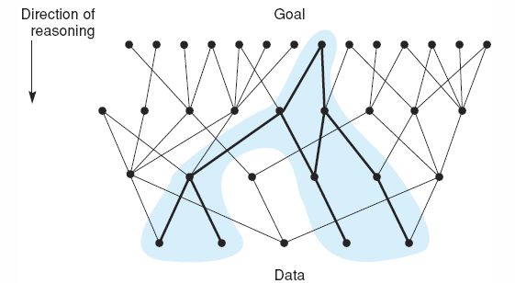
Fig 3.12 State space in which goal-directed search effectively prunes extraneous search paths.

Slide 41
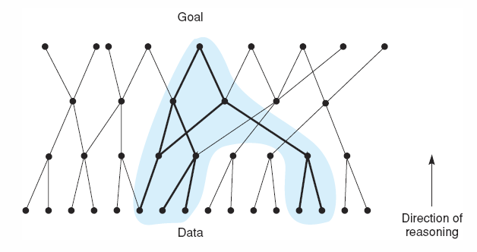
Fig 3.13 State space in which data-directed search prunes irrelevant data and their consequents and determines one of a number of possible goals.

